Slide 1
Algorithmic Trading & Time Series Analyis (with Python Programming)

Slide 2
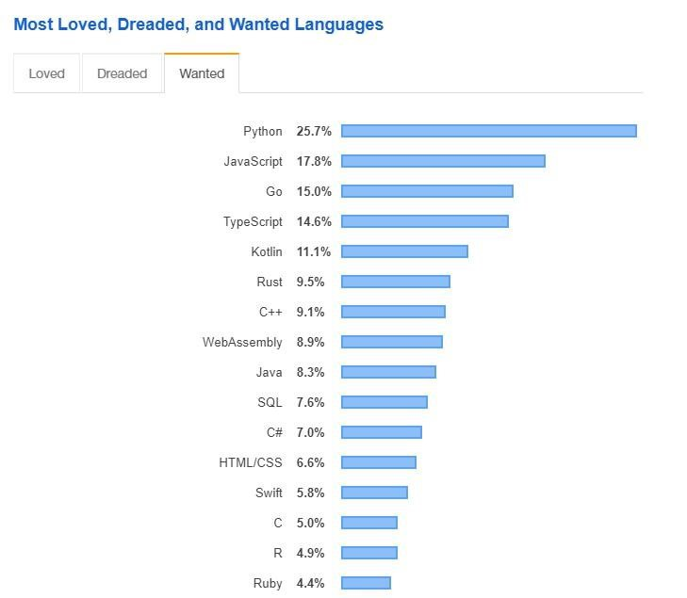
Python Programming Language
Python is the #1 programming language mainly because of scientific computing and machine learning
there are a huge number of libraries you can rely on – SciPy, SkLearn or Keras
data science and artificial intelligence related applications rely extremely heavily on Python
most of the scientific community use Python – physics simulations, complex networks etc.

Slide 3
Python Programming Language
Python is an interpreted programming language
it means that the code is interpreted and processed at run-time so there is no need for compiling the program
it is and object oriented programming language – it may encapsulate code within give classes and objects
easy to use with all the major databases

Slide 4
Why to Use Python?
Python is very easy to learn compared to other
Programming languages such as C or C++

Slide 5
Why to Use Python?
Python is very easy to learn compared to other
Programming languages such as C or C++
several available libraries in machine learning, statistics and numerical methods that significantly reduces time to implementation
(NumPy, SciPy, Pandas + plugins)

Slide 6
Why to Use Python?
Python is very easy to learn compared to other
Programming languages such as C or C++
several available libraries in machine learning, statistics and numerical methods that significantly reduces time to implementation
(NumPy, SciPy, Pandas + plugins)
quite fast (not as fast as C or C++) Python provides scientific computing components that are heavily optimized via vectorization

Slide 7
Stocks (Quantitative Finance)

Slide 8
Stocks
stocks are the ownership of a small piece of a company
this entitles the owner of the stock to a proportion of the corporation’s asset and profits equal to how much stock they own
shares are the units of stocks

Slide 9
Stocks
if you have a good idea then you can raise capital by selling
off future profits in the form of shares
the investor (or shareholder) gives you cash
in return he gets a contract stating how much
of the company he owns
THIS IS HOW SMALL COMPANIES BEGIN !!!

Slide 10
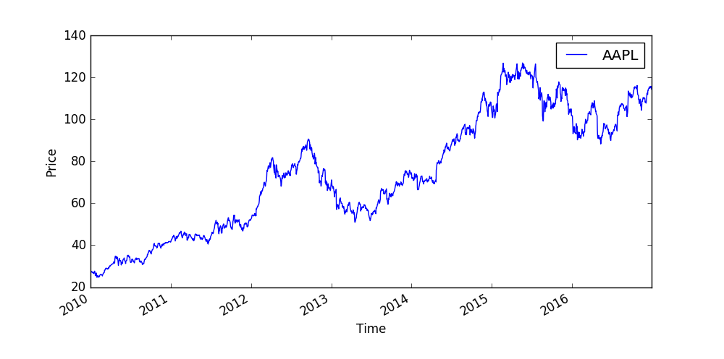
Stocks

Slide 11






Stocks
the STOCK EXCHANGE has
the list of all the companies
that want to raise capital
(brings together buyers and sellers)
investors use BROKER FIRMS
that have the ability to
buy and sell shares
companies that want to
grow their businesses
and want to raise capital
there are the investors
who want to find the right
company to invest in

Slide 12
Stocks
the STOCK EXCHANGE has
the list of all the companies
that want to raise capital
(brings together buyers and sellers)
investors use BROKER FIRMS
that have the ability to
buy and sell shares
companies that want to
grow their businesses
and want to raise capital
there are the investors
who want to find the right
company to invest in

Slide 13
Stocks
the STOCK EXCHANGE has
the list of all the companies
that want to raise capital
(brings together buyers and sellers)
investors use BROKER FIRMS
that have the ability to
buy and sell shares
companies that want to
grow their businesses
and want to raise capital
there are the investors
who want to find the right
company to invest in

Slide 14
Stocks
the STOCK EXCHANGE has
the list of all the companies
that want to raise capital
(brings together buyers and sellers)
investors use BROKER FIRMS
that have the ability to
buy and sell shares
companies that want to
grow their businesses
and want to raise capital
there are the investors
who want to find the right
company to invest in

Slide 15
Stocks
WHY DO STOCK PRICES FLUCTUATE?
we can see that the S(t) stock prices
are usually very similar
to a random walk
STOCK PRICES RISE AND FALL
DUE TO THE FLUCTUATION OF
SUPPLY AND DEMAND !!!
if more people want to buy a given stock
then its market price will increase
S(t)
t

Slide 16
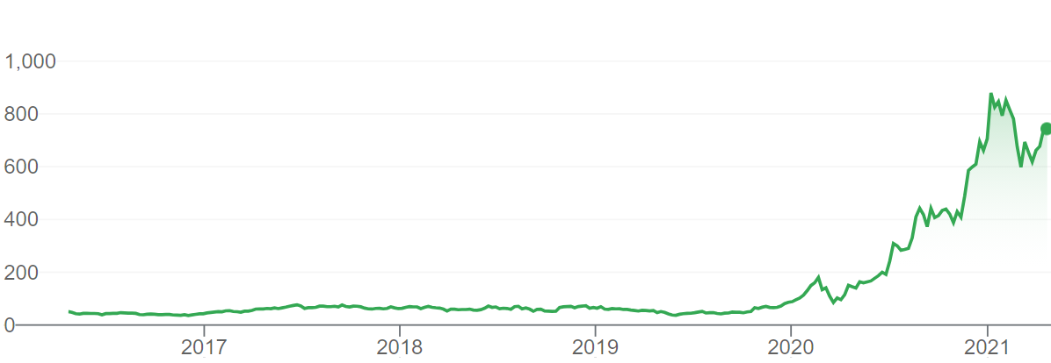
Stocks
WHY IS IT GOOD TO OWN A STOCK?
→ there may be growth in the value of the stock
that can be realized if you sell the given stock
BUT STOCKS ARE CONSIDERED TO BE
A RISKY INVESTMENT !!!

Slide 17
Stocks
WHY IS IT GOOD TO OWN A STOCK?
→ there may be growth in the value of the stock
that can be realized if you sell the given stock
BUT STOCKS ARE CONSIDERED TO BE
A RISKY INVESTMENT !!!
→ there are so-called dividends. These are payments paid
out every quarter or every six months to the shareholders
→ the amount of dividend usually depends on the
profitability of the given company

Slide 18
Stocks
MEASURING THE RISK OF STOCK - VOLATILITY
→ statistical measure of the dispersion of returns for a given security
which is the amount of uncertainty (or risk) about the size of changes
in the value of a given security (stock, bond etc.)
→ we can measure volatility with standard deviation
or variance between returns of the same security
HIGHER THE VOLATILITY THE RISKIER THE SECURITY !!!
→ we can use the Capital Asset Pricing Model (CAPM)
with the β value to approximate volatiliy

Slide 19
Commodities (Quantitative Finance)

Slide 20



Commodities
commodities are raw products such as gold, oil or natural gas
investin into commodities is not that simple
how to actually own a barrel of oil?
USUALLY COMMODITIES (SUCH AS OIL) ARE
EXTREMELY VOLATILE !!!
this is why there are future contracts

Slide 21
Commodities
WHY DO COMMODITY PRICES FLUCTUATE?
we can see that the S(t) commodity prices
are usually very similar
to a random walk
COMMODITY PRICES RISE AND FALL
DUE TO THE FLUCTUATION OF
SUPPLY AND DEMAND !!!
if more people want to buy a given commodity
then its market price will increase
S(t)
t

Slide 22
Commodities
futures contracts are made in an attempt by producers and suppliers of commodities to avoid market volatility
they negotiate the price of a given commodity in the future
„The major cost for airlines is fuel expenses.
So fluctuating oil prices can greatly impact airlines. This is why they use oil futures to protect them from rising oil prices”

Slide 23





Commodities
the FUTURE MARKET is an auction
market in which participants buy and sell
commodity and futures contracts
(New York Mercantile Exchange)
investors use FUTURE BROKER FIRMS
that have the ability to buy
and sell commodities
there are several
commodities like gold, silver,
crude oil or natural gas
there are the investors
or companies that are looking
for commodities

Slide 24
Why Commodities are Useful?
commodities prices typically rise when inflation is accelerating
this is why commodities (oil or gold) usually offer protection from the effects of inflation
COMMODITIES MAY OFFER PROTECTION AGAINTS
THE NEGATIVE EFFECTS OF INFLATION !!!

Slide 25
Why Commodities are Useful?
if we can not invest into a commodity directly then we can invest into a company that relies on the given commodity
for example gold and shares of gold mines may be correlated
of course it may be affected by the company operating performance but usually there is a positive correlation
WE CAN USE PAIRS TRADING STRATEGY !!!

Slide 26
Currencies and the FOREX (Quantitative Finance)

Slide 27
Currencies and the FOREX
in finance an exchange rate is the rate at which one national currency will be exchanged for another
it tells you how much a given currency is worth in another currency
GOVERNMENTS AND CENTRAL BANKS CAN INFLUENCE
CURRENCIES AND EXCHANGE RATES !!!

Slide 28
Currencies and the FOREX
 | USA | EUR | GBP | CHF | CAD
USA | 1 | 0.741 | 0.657 | 1.061 | 1.011
EUR | 1.35 | 1 | 0.889 | 1.433 | 1.366
GBP | 1.521 | 1.126 | 1 | 1.614 | 1.538
CHF | 0.943 | 0.698 | 0.62 | 1 | 0.953
CAD | 0.955 | 0.732 | 0.65 | 1.049 | 1

Slide 29
Currencies and the FOREX
WHY DO EXCHANGE RATES FLUCTUATE?
we can see that the S(t) exchange rates
are usually very similar
to a random walk
EXCHANGE RATES RISE AND FALL
DUE TO THE FLUCTUATION OF
SUPPLY AND DEMAND !!!
if more people want to buy a given currency
then its market price will increase
S(t)
t

Slide 30

FOREX
the FOREX MARKET is the market
for trading international currencies
investors use FOREX BROKER
FIRMS that have the ability
to buy and sell currencies
there are several
currencies like USD, CAD,
YEN or GBP
there are several investors
that are looking for
international currencies

Slide 31
Factors Affecting Exchange Rates
– INTEREST RATES –
the interest rate is a major factor that can be manipulated by the
central bank of a country. Investors will lend money to the banks
of the given country for higher returns

Slide 32
Factors Affecting Exchange Rates
– INTEREST RATES –
the interest rate is a major factor that can be manipulated by the
central bank of a country. Investors will lend money to the banks
of the given country for higher returns
– MONEY SUPPLY –
the money supply created by the central bank by printing too much currency may trigger inflation. Investors do not like inflation so they
will leave the currency that can push the value of a currency down.

Slide 33
Factors Affecting Exchange Rates
– INTEREST RATES –
the interest rate is a major factor that can be manipulated by the
central bank of a country. Investors will lend money to the banks
of the given country for higher returns
– MONEY SUPPLY –
the money supply created by the central bank by printing too much currency may trigger inflation. Investors do not like inflation so they
will leave the currency that can push the value of a currency down.
– FINANCIAL STABILITY –
the financial stability and economic growth of a given country
have a huge impact on the value of the exchange rate

Slide 34
Arbitrage on the FOREX
We can construct a directed graph G(V,E) out of
the exchange rate table with V currencies
→ the V nodes of the graph are the currencies
→ the E edges are the relative values
We take the natural logarithm of the edges
and mutiply the edges by -1
We end up with a negative edge weighted G’(V,E)
Graph where the negative cycles are the
arbitrage opportunities
USD
GBP
EUR
CHF
CAD
WE CAN USE BELLMAN-FORD SHORTEST PATH ALGORITHM TO FIND NEGATIVE CYCLES IN O(V*E) RUNNING TIME !!!

Slide 35
Long and Short Positions (Quantitative Finance)

Slide 36
Long Position
long position in a security means that you own the security
investors maintain long positions in the expectation that the stock will increase in value in the future
S(t)
of course the investor can make
a profit in this case with a long position
because S(t_{T}) > S(t₀)
SO INVESTORS CAN MAKE A PROFIT
BY MAINTAINING A LONG POSITION !!!
t
t₀
t_{T}

Slide 37
Short Position
short position in a security means that you sell the security
investors maintain short positions in the expectation that the stock will decrease in value in the future
S(t)
of course the investor can make
a profit in this case with a short position
because S(t_{T}) < S(t₀)
SO INVESTORS CAN MAKE A PROFIT
BY MAINTAINING A SHORT POSITION !!!
short selling means you sell something
you do not actually own
t
t₀
t_{T}

Slide 38
Short Position
”Short-selling is when an investor borrows shares and immediately sells them – hoping he can buy them up later at a lower price return them to the lender and pocket the difference”

Slide 39
Risks with Short and Long Positions
shorting is much riskier than opening long positions
when you open long position then your maximum possible loss is 100% so you may lose your entire initial investment
with short selling there is no limit to how much you can lose
because there is no limit for the given stock to increase in value

Slide 40


Bearish and Bullish Markets
a bear market is when the market experiences
stable price declines
→ so when securities fall for a sustained period of time
SO THIS IS WHEN WE CAN MAKE A PROFIT WITH SHORT POSITIONS
a bull market is when the market experiences
stable price increase
→ so when securities are on the rise for a sustained period of time
SO THIS IS WHEN WE CAN MAKE A PROFIT WITH LONG POSITIONS

Slide 41
Types of Analyses (Algorithmic Trading)

Slide 42
Types of Analyses
– FUNDAMENTAL ANALYSIS –
it deals with the intrinsic value of a given company
to determine whether to buy the stock or not

Slide 43
Types of Analyses
– FUNDAMENTAL ANALYSIS –
it deals with the intrinsic value of a given company
to determine whether to buy the stock or not
– TECHNICAL ANALYSIS –
it tries to predict the given assets’ future prices

Slide 44
Types of Analyses
– FUNDAMENTAL ANALYSIS –
it deals with the intrinsic value of a given company
to determine whether to buy the stock or not
– TECHNICAL ANALYSIS –
it tries to predict the given assets’ future prices
– QUANTITATIVE ANALYSIS –
it uses rather complicated mathematical models

Slide 45
Fundamental Analyis
fundamental analysis is about in-depth study of the given company
management teams, products and services,balance sheets and competitors
we take these factors and predict the stock price according to the intrinsic value of a company
fundamental analysis do not
care about predicting the
future prices of the stocks
IT DEALS WITH THE INTRINSIC
VALUE OF THE COMPANIES !!!

Slide 46
Technical Analyis
technical analysis is a opposite of fundamental analysis – this approach does not care about the company
all the information is contained within its stock
we have to analyse historical data, look for specific patterns in the share price to make predictions accordingly
S(t)
technical analysis do not
care about the underlying company
and the intrinsic value
TECHNICAL ANALYSIS IS
ABOUT HISTORICAL DATA !!!
t

Slide 47
Quantitative Analyis
quantitative analysis is mathematical heavy – it relies on complex mathematical models and implementations
it has the assumption that all financial quantities such as stock prices or interest rates has random behavior
we have to use randomness in our models such as stochastic calculus and stochastic differential equations
S(t)
Coca-Cola
quantitative analysis has the tendency
to combine underlying assets
to reduce market tisk
BLACK-SCHOLES MODEL IS A
TYPICAL QUANTITATIVE APPROACH !!!
Pepsi
t

Slide 48
Stationarity (Algorithmic Trading)

Slide 49
Stationary Processes
S(t)
time series analysis assumes that
the given time series is a realization
of a given random variable
WE TRY TO FIND THE BEST GENERATING
PROCESS FOR THE SERIES !!!
t

Slide 50
Stationary Processes
1.) a time series is stationary (as far as the mean is concerned)
if the mean is constant
μ(t) = μ
the mean of the given x(t)
time series is E(x(t)) = μ(t)

Slide 51
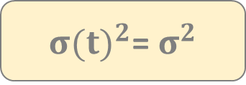
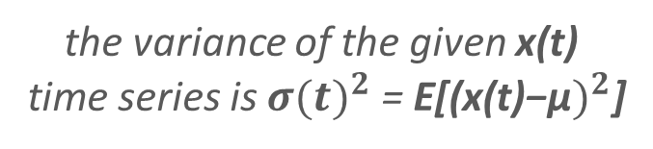
Stationary Processes
1.) a time series is stationary (as far as the mean is concerned)
if the mean is constant
μ(t) = μ
the mean of the given x(t)
time series is E(x(t)) = μ(t)
2.) a time series is stationary (as far as the variance is concerned)
if the variance is constant
${σ(t)}^{2}$= $σ^{2}$
the variance of the given x(t)
time series is ${σ(t)}^{2}$ = E[(${\text{x}\text{(}\text{t}\text{)−}\text{μ})}^{2}$]
BUT some x(t) observations may be correlated: so we may over-
or underestimate the actual variance

Slide 52
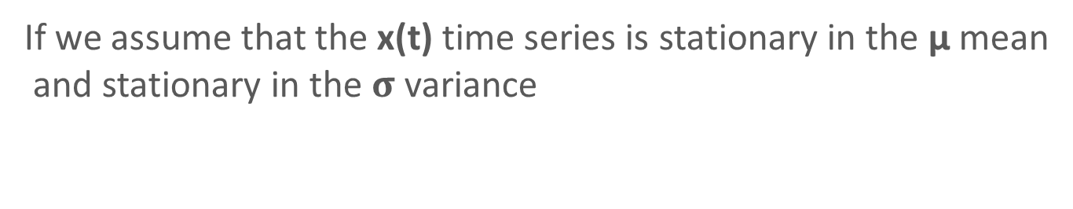
Stationary Processes
STATIONARITY IN TIME SERIES
If we assume that the x(t) time series is stationary in the μ mean
and stationary in the $σ$variance
THE TIME SERIES IS SECOND ORDER STATIONARY !!!
A given x(t) time series is second order stationary if the
correlation between the observations is the function of
the lag exclusively (so the function of time steps
separating each sequential observations)

Slide 53
Stationary Processes
STATIONARITY IN TIME SERIES
non-stationary process
(random walk)
stationary process
(white noise)
transformation such as
x(t)-x(t-1) differencing
non-stationary data is unpredictable and can not be modeled
we transform non-stationary processes into stationary
processes so that we can build models

Slide 54
Serial Correlation (Algorithmic Trading)

Slide 55
Time Series
S(t)
time series analysis assumes that
the given time series is a realization
of a given random variable
WE TRY TO FIND THE BEST GENERATING
PROCESS FOR THE SERIES !!!
t

Slide 56
Time Series
1.) autocorrelation: time series related observations
that are close together in time are usually correlated
2.) trends: a trend is the general direction of a market or a price
of a given asset such as stocks
TRENDS ARE EXTREMELY COMMON IN TIME SERIES !!!
For example seasonal variation in commodities,
annual temperature variation for natural gas
r₁ r₂ r₃ r₄ ... r_{n}
this is exactly what happens
when dealing with the daily
returns of an S(t) stock

Slide 57
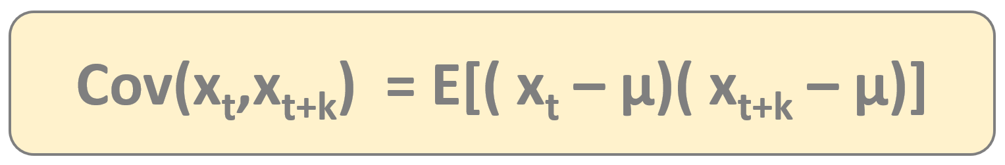
Serial Covariance
Autocovariance (serial covariance) for second order stationary time series
A given an x(t) stochastic process the autocovariance is a
function that gives the covariance of the process
with itself at pairs of time points

Slide 58
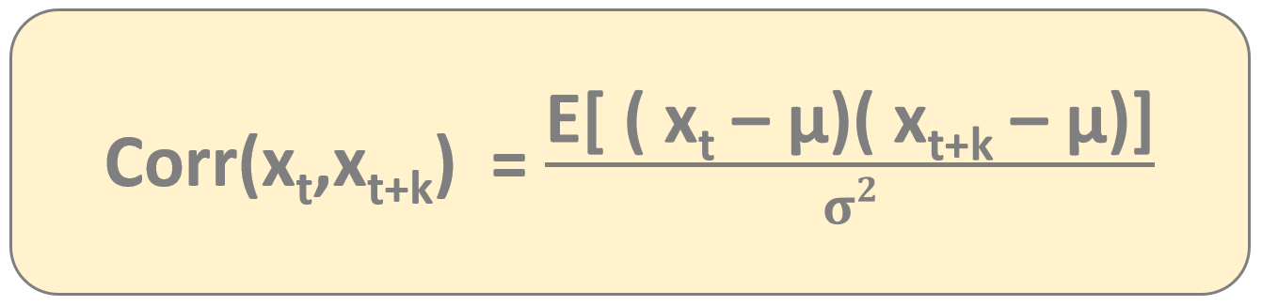
Serial Correlation
Autocorrelation (serial correlation) for second order stationary time series
A given an x(t) stochastic process the autocorrelation is a
function that gives the corerlation of the process
with itself at pairs of time points

Slide 59
Serial Correlation
S(t)
x₁
x₂
x₃
x₄
x₅
x₆
t

Slide 60
Serial Correlation
S(t)
x₁
x₂
x₃
x₄
x₅
x₆
x₁
x₂
x₃
x₄
x₅
x₆
t
we can caculate the autocorrelation
between the shifted stock price values
WE HAVE TO USE THE VALUES OF THE SAME TIME SERIES !!!

Slide 61
Serial Correlation
LAG = 0
S(t)
x₁
x₂
x₃
x₄
x₅
x₆
x₁
x₂
x₃
x₄
x₅
x₆
t
we can caculate the autocorrelation
between the shifted stock price values
WE HAVE TO USE THE VALUES OF THE SAME TIME SERIES !!!

Slide 62
Serial Correlation
LAG = 1
S(t)
x₁
x₂
x₃
x₄
x₅
x₆
x₁
x₂
x₃
x₄
x₅
x₆
t
we can caculate the autocorrelation
between the shifted stock price values
WE HAVE TO USE THE VALUES OF THE SAME TIME SERIES !!!

Slide 63
Serial Correlation
LAG = 2
S(t)
x₁
x₂
x₃
x₄
x₅
x₆
x₁
x₂
x₃
x₄
x₅
x₆
t
we can caculate the autocorrelation
between the shifted stock price values
WE HAVE TO USE THE VALUES OF THE SAME TIME SERIES !!!

Slide 64
Serial Correlation
LAG = 3
S(t)
x₁
x₂
x₃
x₄
x₅
x₆
x₁
x₂
x₃
x₄
x₅
x₆
t
we can caculate the autocorrelation
between the shifted stock price values
WE HAVE TO USE THE VALUES OF THE SAME TIME SERIES !!!

Slide 65
Autocorrelation
sometimes autocorrelation is useful and it can help us beter understand the data
it can help us uncover hidden patterns in out data – such as seasonality or trends in commodities
but there are other cases when we want to get rid of it
when we do regression modeling then we have to make sure the residuals have no autocorrelation – so the errors are independent and identically distributed

Slide 66
Autocorrelation
the aim of time series models is to explain serial correlation
after fitting a given model to the data we should make sure there is no serial correlation
WE SHOULD FIND MODELS WHERE THERE
IS NO SERIAL CORRELATION !!!

Slide 67
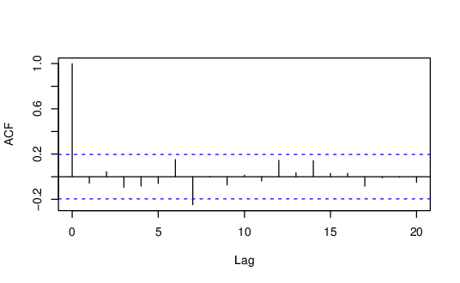
Correlogram
with the autocorrelation plot
or the so-called correlogram we can
check serial correlation
IT IS EXTREMELY USEFUL TO EVALUATE TIME SERIES MODELS !!!
plot of the autocorrelation function for
sequential values of lag

Slide 68
Trading Strategy (Algorithmic Trading)

Slide 69
Time Series
x₁
x₂
x₃
x₄
x₅
x₆
x₇
x₈
x₉
x₁₀
x₁₁
x₁₂

Slide 70
Time Series
x₁
x₂
x₃
x₄
x₅
x₆
x₇
x₈
x₉
x₁₀
x₁₁
x₁₂

Slide 71
Time Series
x₁
x₂
x₃
x₄
x₅
x₆
x₇
x₈
x₉
x₁₀
x₁₁
x₁₂
we use the training set to train
the ARIMA model
THIS IS HOW WE FIND THE OPTIMAL p AND q PARAMETERS !!!

Slide 72
Time Series
x₁
x₂
x₃
x₄
x₅
x₆
x₇
x₈
x₉
x₁₀
x₁₁
x₁₂
we use the test set to test
the ARIMA model
BUT WITH THIS APPROACH WE DO NOT CONSIDER THE PREVIOUS PRICES !!!

Slide 73
Time Series
TEST SET
x₁
x₂
x₃
x₄
x₅
x₆
x₇
x₈
x₉
x₁₀
x₁₁
x₁₂

Slide 74
Time Series
TEST SET
x₁
x₂
x₃
x₄
x₅
x₆
x₇
x₈
x₉
x₁₀
x₁₁
x₁₂

Slide 75
Time Series
TEST SET
x₁
x₂
x₃
x₄
x₅
x₆
x₇
x₈
x₉
x₁₀
x₁₁
x₁₂

Slide 76
Time Series
TEST SET
x₁
x₂
x₃
x₄
x₅
x₆
x₇
x₈
x₉
x₁₀
x₁₁
x₁₂

Slide 77
Time Series
TEST SET
x₁
x₂
x₃
x₄
x₅
x₆
x₇
x₈
x₉
x₁₀
x₁₁
x₁₂

Slide 78
Moving Average Indicator (Algorithmic Trading)

Slide 79
Moving Average Indicator
simple moving averages were first used back in 1901
this is maybe the most popular technical indicator
it is the arithmetic mean of a given asset’s price over the specific number of days in the past
calculating the moving average of a stock helps to smooth out the price data over a specified period of time
WE CAN FILTER OUT NOISE WITH THE HELP OF THE MOVING AVERAGE (SMA) INDICATOR

Slide 80
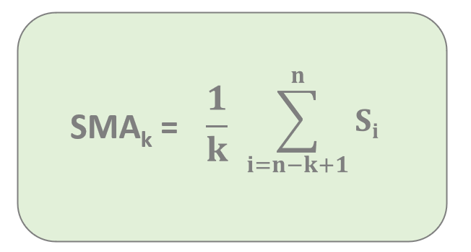
Moving Average Indicator
S(t)
simple moving average (SMA) is
the unweighted mean of the
previous S(t) stock prices
t

Slide 81


Moving Average Indicator
S(t)
$$\sum_{i=n−k+1}^{n}{Si}$$
SMA_{k} =
$$\frac{1}{k}$$
simple moving average (SMA) is
the unweighted mean of the
previous S(t) stock prices
t
x₁
x₂
x₃
x₄

Slide 82
Moving Average Indicator
S(t)
simple moving average (SMA) is
the unweighted mean of the
previous S(t) stock prices
t
x₂
x₃
x₄
x₅

Slide 83
Moving Average Indicator
S(t)
simple moving average (SMA) is
the unweighted mean of the
previous S(t) stock prices
t
x₃
x₄
x₅
x₆

Slide 84
Moving Average Indicator
S(t)
simple moving average (SMA) is
the unweighted mean of the
previous S(t) stock prices
t
x₄
x₅
x₆
x₇

Slide 85
Moving Average Indicator
LONG TIME PERIODS
(SLOW SMA)
popular time ranges are
50, 100 and 200
less sensitive to price changes
so it is smooth
long term moving averages are
useful when dealing with
long term investing
SHORT TIME PERIODS
(FAST SMA)
popular time ranges are
15, 20 and 30
more sensitive to price changes
so not that smooth
short term moving averages are
useful when dealing with short
term investing and day trading

Slide 86
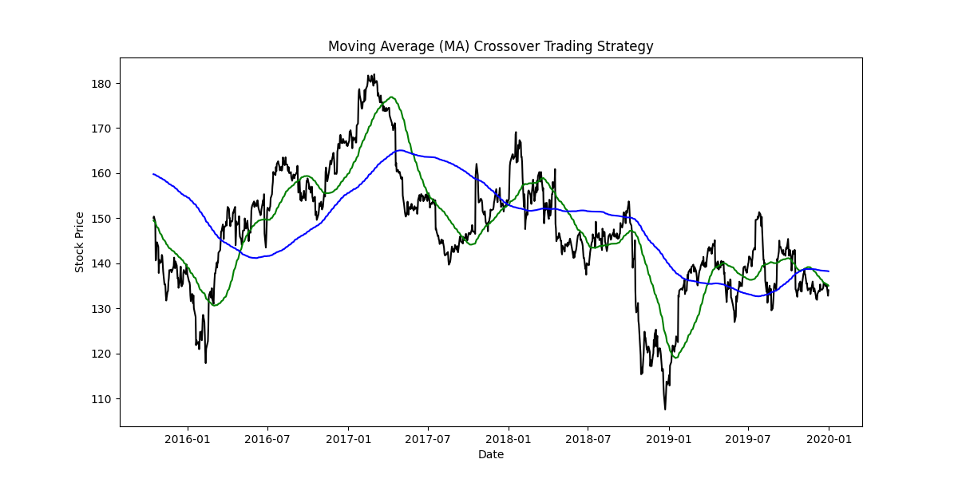
Moving Average Indicator

Slide 87
SMA and Resistance Levels (Algorithmic Trading)

Slide 88
Moving Average Indicator
the most common applications of SMA is to determine trend directions and to identify support and resistance levels
when the S(t) prices crosses their moving averages – these are usually trading signals

Slide 89
Support Level
during a bullish market (uptrend)
the slow SMAs can define the
so-called support levels
SUPPORT LEVELS ARE PRICE LEVELS
THAT AN ASSET DOES NOT FALL BELOW
FOR SOME PERIOD OF TIME !!!
we can detect these support levels
with short as well as with fast
period moving averages
S(t)
t

Slide 90
Resistance Level
during a bearish market (downtrend)
the slow SMAs can define the
so-called resistance levels
RESISTANCE LEVELS ARE THE UPPER
BOUNDS OF STOCK PRICES FOR
SOME PERIOD OF TIME !!!
we can detect these resistance levels
with short as well as with fast
period moving averages
S(t)
t

Slide 91
Exponential Moving Average (Algorithmic Trading)

Slide 92
Exponential Moving Average (EMA) Indicator
it is similar to simple moving average indicator but here we introduce weighting factors that decrease exponentially
simple moving average (SMA) is
the unweighted mean of the
previous S(t) stock prices
HERE WE ARE DEALING WITH THE EXPONENTIALLY WEIGHTED STOCK PRICES !!!
so recent S(t) stock prices are
more important in this model

Slide 93
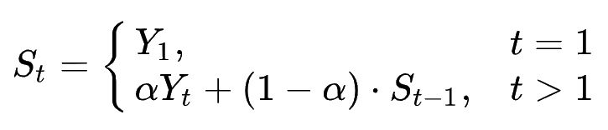
Exponential Moving Average (EMA) Indicator
exponential moving average (EMA) is
the weighted mean of the
previous S(t) stock prices
the α symbol represents the
degree of decrease
S(t)
t

Slide 94
Exponential Moving Average (EMA) Indicator
exponential moving average (EMA) is
the weighted mean of the
previous S(t) stock prices
the α symbol represents the
degree of decrease
S(t)
t
x₁
x₂
x₃
x₄

Slide 95
Exponential Moving Average (EMA) Indicator
exponential moving average (EMA) is
the weighted mean of the
previous S(t) stock prices
the α symbol represents the
degree of decrease
S(t)
t
x₂
x₃
x₄
x₅

Slide 96
Exponential Moving Average (EMA) Indicator
exponential moving average (EMA) is
the weighted mean of the
previous S(t) stock prices
the α symbol represents the
degree of decrease
S(t)
t
x₃
x₄
x₅
x₆

Slide 97
Exponential Moving Average (EMA) Indicator
exponential moving average (EMA) is
the weighted mean of the
previous S(t) stock prices
the α symbol represents the
degree of decrease
S(t)
t
x₄
x₅
x₆
x₇

Slide 98
Relative Strength Indicator (Algorithmic Trading)

Slide 99
Relative Strength Indicator
this index was first used in 1978 by J. Welles Wilder
it is a momentum oscillator that measures the speed and change of price movements
WE CAN MEASURE OVERBOUGHT AND OVERSOLD
CONDITIONS IN THE PRICE OF AN ASSET !!!
relative strength index is a value in the range [0, 100]

Slide 100
Relative Strength Indicator
the relative strength indicator (RSI)
is a common technical analysis
related index
IT HELPS TO IDENTIFY BULLISH AND BEARISH PRICE MOMENTUM !!!
we can detect these support levels
with short as well as with fast
period moving averages

Slide 101
Relative Strength Indicator
the relative strength indicator (RSI)
is a common technical analysis
related index
IT HELPS TO IDENTIFY BULLISH AND BEARISH PRICE MOMENTUM !!!
an asset is considered to be oversold
if the RSI is below 30%

Slide 102
Relative Strength Indicator
the relative strength indicator (RSI)
is a common technical analysis
related index
IT HELPS TO IDENTIFY BULLISH AND BEARISH PRICE MOMENTUM !!!
an asset is considered to be overbought
if the RSI is above 70%

Slide 103
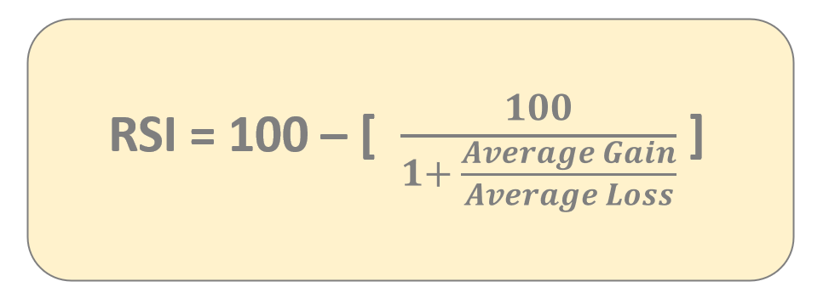
Relative Strength Indicator
the standard is to use 14 day period
to calculate the average gain and average loss values
IT HELPS TO IDENTIFY BULLISH AND BEARISH PRICE MOMENTUM !!!

Slide 104
Arithmetic & Logarithmic Returns (Algorithmic Trading)

Slide 105
Returns
in finance the return is a profit on a given investment
of course the loss can be defined as a negative return
usually we convert each return into a return over a period of time of a standard length to be able to compare different returns of different investments

Slide 106

Returns
the return can be calculated over
a single period (day, month or year)
this is how we can calculate daily
returns for given S(t) stock prices
S(t)
R_{t} = $\frac{S\left(t+1\right) −S(t)}{S(t)}$
t

Slide 107

Returns
the return can be calculated over
a single period (day, month or year)
this is how we can calculate log daily
returns for given S(t) stock prices
S(t)
r_{t} = log ( $\frac{S\left(t+1\right) }{S(t)}$ )
t

Slide 108
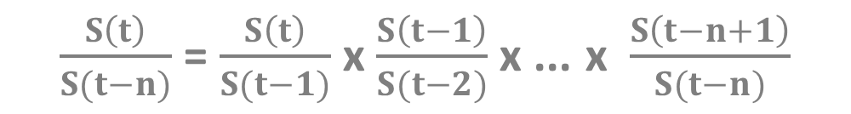
Returns
let’s calculate the return for
the next n periods
this is how we can calculate daily
returns for given S(t) stock prices
$\frac{S\left(t\right)}{S(t−n)}$ = $\frac{S\left(t\right)}{S(t−1)}$ x $\frac{S\left(t−1\right)}{S(t−2)}$ x ... x $\frac{S\left(t−n+1\right)}{S(t−n)}$
(1+R_{t}) x (1+R_{t-1}) x ... x (1+R_{t-n+1})

Slide 109
Returns
let’s calculate the log return for
the next n periods
this is how we can calculate log daily
returns for given S(t) stock prices
log [(1+R_{t}) x (1+R_{t-1}) x ... x (1+R_{t-n+1})]
r_{t} + r_{t-1} + ... + r_{t-n+1}

Slide 110
Returns
when dealing with arithmetic daily returns for some period then we have to multiply the returns
THE PRODUCT OF NORMALLY DISTRIBUTED
VARIABLES IS NOT NORMAL !!!
when using logarithmic daily returns for some period then we have to multiply the returns
but because of the logarithmic function properties we have to sum up the logarithmic returns
THE SUM OF NORMALLY DISTRIBUTED
VARIABLES IS NORMAL !!!

Slide 111
Returns
we can use log daily returns to normalize the dataset
and we can remove trends (differencing operator) so we end up with a stationary series that is more convenient to analyze

Slide 112
Sharpe Ratio (Algorithmic Trading)

Slide 113
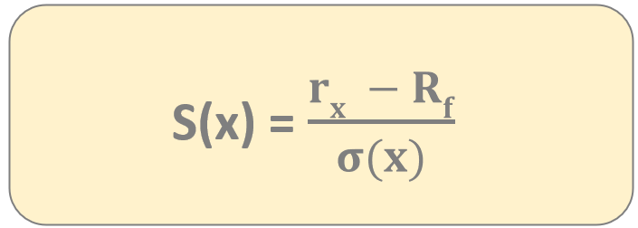
Sharpe Ratio
it is one of the most important risk and return measures used in
quantitative finance – it was first used by William Sharpe
it describes how much excess return you are receiving
for extra volatility that you endure holding a riskier asset (stock)
a Sharpe-ratio S(x) > 1
is considered to be good
r_{x}
average rate of return of investment x
R_{f}
rate of return of risk-free security

Slide 114
Risks in Finance (Algorithmic Trading)

Slide 115
Risks in Finance
holding just a single stock is quite risky
we should hold a portfolio of stocks to reduce risk – this is what we can optimize with the Markowitz-model

Slide 116
Risks in Finance
holding just a single stock is quite risky
we should hold a portfolio of stocks to reduce risk – this is what we can optimize with the Markowitz-model
BUT UNFORTUNATELY WE CAN NOT GET RID OF
ALL THE RISK WHEN BUYING MULTIPLE STOCKS !!!

Slide 117
Risks in Finance
– UNSYSTEMATIC (SPECIFIC) RISK –
This is the risk specific to individual stocks. It can be diverzified away by holding multiple stocks in a portfolio. Unsystematic risk is the component of a stock’s return that is not correlated with market moves.

Slide 118
Risks in Finance
– UNSYSTEMATIC (SPECIFIC) RISK –
This is the risk specific to individual stocks. It can be diverzified away by holding multiple stocks in a portfolio. Unsystematic risk is the component of a stock’s return that is not correlated with market moves.
– SYSTEMATIC (MARKET) RISK –
This risk can not be diverzified away. This is the risk because of
interest rate changes, recession or war. The CAPM model measures
This risk with the β parameter.

Slide 119
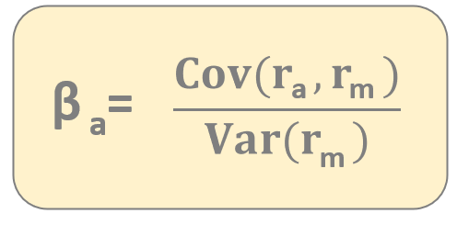
Risks in Finance
the parameter defines how risky
your portfolio relative to the market
→ if your portfolio has no risk then your expected return is the
risk-free return (you can lend your money to a bank or bonds)
→ your portfolio is more risky than the market: your return
will be higher of course
→ your portfolio less risky than the market: less return
β = 1 stock moving exactly with the market has beta 1
β > 1 given stock is more volatile than the market (more expected return)
β < 1 given stock is less volatile than the market (less expected return)

Slide 120
Hedging the Market Risk (Algorithmic Trading)

Slide 121
Hedging the Market Risk
the Capital Asset Pricing Model (CAPM) shows us the relationship between risk and return
we can not eliminate all the risks in finance
„If you want to make some money, you have to take risks”

Slide 122
Hedging the Market Risk
but there are some strategies that have managed to reduce and eliminate market risk
BLACK-SCHOLES MODEL

Slide 123
Hedging the Market Risk
but there are some strategies that have managed to reduce and eliminate market risk
BLACK-SCHOLES MODEL
PAIRS-TRADING STRATEGY

Slide 124
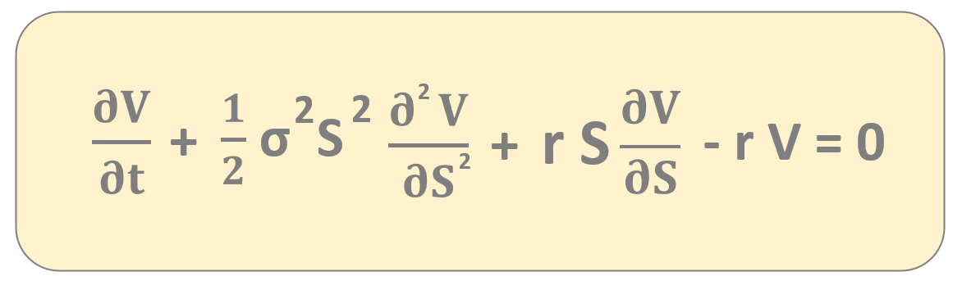
Black-Scholes Model
this is the famous Black-Scholes formula
it deals with a portfolio a derivative (option) and
and underlying stock
RISKY POSITIONS TAKEN TOGETHER CAN EFFECTIVELY ELIMINATE RISK ITSELF !!!

Slide 125
Pairs-Trading Strategy
Pairs-trading strategy is about combining long and short positions in a pair of
highly correlated financial instruments (such as stocks)
→ it is a form of statistical-arbitrage strategy
developed in the 1980s at Morgan-Stanley company
S(t)
Pepsi (PEP) and CocaCola (KO) are companies
with similar products – they are historically correlated
if PEP goes up a significant amount while KO stays the same
pairs trader should buy KO stock and sell PEP stock
TRADERS ASSUME THE COMPANIES WOULD RETURN TO THEIR HISTORICAL BALANCE POINT !!!
Coca-Cola
Pepsi
t

Slide 126
Stochastic Processes (Algorithmic Trading)

Slide 127
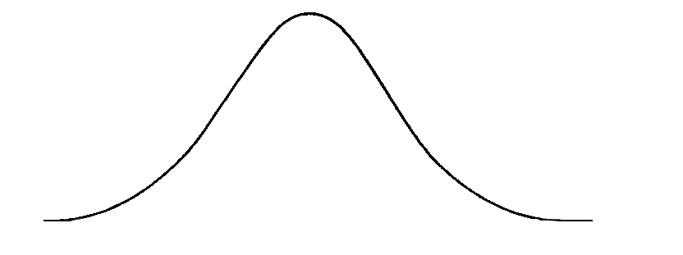
Stochastic Processes
WIENER-PROCESS
→ W(t) has independent increments: future W(t+dt) – W(t)
increments are independent of past values
W(t) has Gaussian increments: W(t+dt)-W(t) is normally
distributed with mean 0 and variance dt
W(t+dt) – W(t) ~ N(0,dt)
S(t)
asset
tomorrow
asset today
Wiener-process W(t) has continuous paths !!!
t

Slide 128
Stochastic Processes
ORNSTEIN-UHLENBECK PROCESS
dx_{t} = θ(μ-x_{t})dt + σ dW_{t}
this process forms the basis of the model for interest rates
(such as the Vasicek model) or currency exchange rates
(this process is stationary while brownian motion is not)
one application of this process is pairs trading strategy

Slide 129
Stochastic Processes
ORNSTEIN-UHLENBECK PROCESS
σ is the degree of volatility
around the μ mean
dx_{t} = θ(μ-x_{t})dt + σ dW_{t}
μ is the equilibrium or the
mean value and θ is the rate by which the
process reverts towards the mean

Slide 130
Stochastic Processes
ORNSTEIN-UHLENBECK PROCESS
pairs-trading strategy has something to do with mean reversion
we open long or short positions when the given x(t) time series
is far away from the mean under the expectation that x(t)
will revert towards the mean
S(t)
if PEP goes up a significant amount while KO stays the same
pairs trader should buy KO stock and sell PEP stock
TRADERS ASSUME THE COMPANIES WOULD RETURN TO THEIR HISTORICAL BALANCE POINT !!!
Coca-Cola
Pepsi
t

Slide 131
Cointegration (Algorithmic Trading)

Slide 132
Cointegration
we do not like non-stationary
time series because there may be
spurious relationships
VARIABLES ARE ASSOCIATED BUT NOT CASUALLY RELATED !!!
we could use regression and
estimate the strength of relatinship
between x(t) and y(t)
S(t)
x(t)
y(t)
t

Slide 133
Cointegration
y = α + β x
we do not like non-stationary
time series because there may be
spurious relationships
VARIABLES ARE ASSOCIATED BUT NOT CASUALLY RELATED !!!
we could use regression and
estimate the strength of relatinship
between x(t) and y(t)
y(t)
x(t)

Slide 134
Cointegration
so usually we avoid handling non-stationary time series
but now we have no other option but to use 2 non-stationary time series – the S(t) prices of stocks
this is why we need to consider cointegration

Slide 135
Cointegration
we can find a β constant value such
that y_{t} – β x_{t} = I(0) is a stationary
process (such as white noise)
WITH THIS TRANSFORMATION WE END UP WITH A STTATIONARY PROCESS !!!
if we can find a β parameter then
x(t) and y(t) are cointegrated
so there may be a true long term
relationship between these variables
S(t)
y(t)
β x(t)
t

Slide 136
Backtrader (Algorithmic Trading)

Slide 137
Backtrader
backtrader is a Python library that helps in strategy development and testing for algorithmic traders of the financial markets
it is an open-source framework that allows for strategy testing on historical data
no need to implement the strategies and indicators from scratch

Slide 138
Backtrader
C E R E B R O

Slide 139
Backtrader
C E R E B R O
S T R A T E G Y

Slide 140
Backtrader
C E R E B R O
S T R A T E G Y
D A T A

Slide 141
Backtrader
S(t)
y(t)
t

Slide 142
Backtrader
S(t)
y(t)
t
x₁

Slide 143
Backtrader
S(t)
y(t)
t
x₁
x₂

Slide 144
Backtrader
S(t)
y(t)
t
x₁
x₂
x₃

Slide 145
Backtrader
S(t)
y(t)
t
x₁
x₂
x₃
x₄

Slide 146
Backtrader
S(t)
y(t)
t
x₁
x₂
x₃
x₄
x₅

Slide 147
Backtrader
S(t)
y(t)
t
x₁
x₂
x₃
x₄
x₅
x₆

Slide 148
Backtrader
S(t)
y(t)
t
x₁
x₂
x₃
x₄
x₅
x₆
x₇

Slide 149
Backtrader
S(t)
y(t)
t
x₁
x₂
x₃
x₄
x₅
x₆
x₇
x₈

Slide 150
Backtrader
S(t)
y(t)
t
x₁
x₂
x₃
x₄
x₅
x₆
x₇
x₈
x₉

Slide 151
Backtrader
S(t)
y(t)
t
0

Slide 152
Backtrader
S(t)
y(t)
t
-1
0

Slide 153
Backtrader
S(t)
y(t)
t
-2
-1
0

Slide 154
Backtrader
S(t)
y(t)
t
-3
-2
-1
0

Slide 155
Backtrader
S(t)
y(t)
t
-4
-3
-2
-1
0

Slide 156
Backtrader
S(t)
y(t)
t
-5
-4
-3
-2
-1
0

Slide 157
Momentum Trading Strategy (Algorithmic Trading)

Slide 158
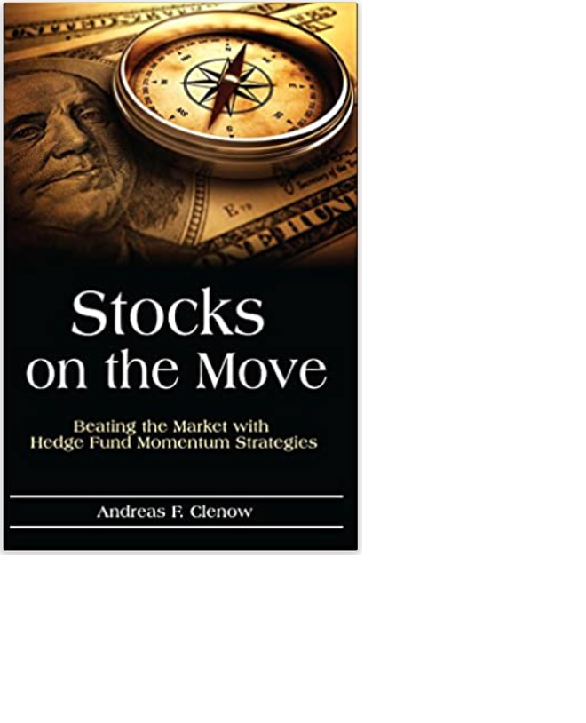
Momentum Trading Strategy
Andreas E. Clenow
- Stocks on the Move -
interesting trading strategy with
combined momentum and moving average
(SMA) indicators

Slide 159
Momentum Trading Strategy
this strategy finds stocks with high momentum – which means that we expect the stock prices to increase in value
we open long positions (and close these positions) during this specific trading strategy
the size of the positions are calculated based on the Average True Range (ATR) indicator

Slide 160
Momentum Trading Strategy
we trade once in a week and update the portfolio (if needed) once in every second week

Slide 161
Momentum Trading Strategy
we trade once in a week and update the portfolio (if needed) once in every second week
open trades when the S&P500 is above it’s SMA

Slide 162
Momentum Trading Strategy
we trade once in a week and update the portfolio (if needed) once in every second week
open trades when the S&P500 is above it’s SMA
rank the stocks in the S&P500 index based on mementum
(we can use regression based on the past 90 days)

Slide 163
Momentum Trading Strategy
we trade once in a week and update the portfolio (if needed) once in every second week
open trades when the S&P500 is above it’s SMA
rank the stocks in the S&P500 index based on mementum
(we can use regression based on the past 90 days)
buy stocks that are in the top 20% momentum range

Slide 164
Momentum Trading Strategy
we trade once in a week and update the portfolio (if needed) once in every second week
open trades when the S&P500 is above it’s SMA
rank the stocks in the S&P500 index based on mementum
(we can use regression based on the past 90 days)
buy stocks that are in the top 20% momentum range
sell stocks that are not in the top 20% momentum range
or their prices have fallen below their SMA

Slide 165
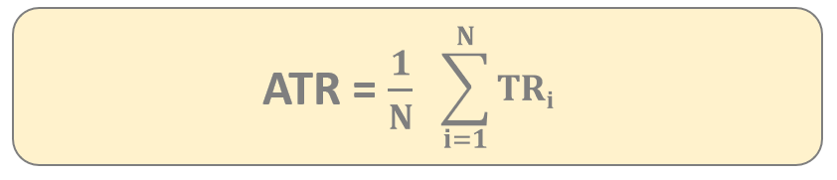
Average True Range (ATR) Indicator
this indicator was first used by J. Welles Wilder
we can measure market volatility by measuring the entire range of an asset price for a given period
TR = max{H-L, abs(H-C_{p}), abs(L-C_{p})}

Slide 166
Average True Range (ATR) Indicator
S(t)
average true range (ATR)
indicator can measure
volatility of a given asset
HIGHER THE ATR INDICATOR VALUE THE MORE VOLATILE THE ASSET !!!
in this example y(t) stock is more
volatile than x(t) stock
y(t)
x(t)
t

Slide 167
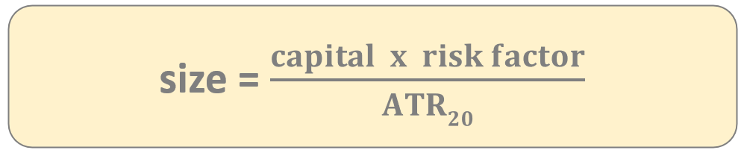
Average True Range (ATR) Indicator
average true range (ATR)
indicator can measure
volatility of a given asset
IN THE TRADING STRATEGY WE WANT TO AVOID INCLUDING HIGHLY VOLATILE ASSETS !!!
this is how we can avoid stocks
with high volatility
S(t)
y(t)
x(t)
t

Slide 168
Regression
if we apply standard linear regression
then we get the β coefficient
THE β SLOPE TELLS HOW HOW MUCH THE
LINE SHOULD GO UP OR DOWN FOR
EACH SUCCESSIVE DATA POINT !!!
so the slope tells us the direction
and momentum of the given stock
S(t)
S(t) = α + β t
t

Slide 169
Regression
if we apply standard linear regression
then we get the β coefficient
THE PROBLEM IS THAT THE β SLOPE IS
EXPRESSED IN DOLLARDS
(INSTEAD OF %) !!!
if a stock that is priced at $20 moves up
by $1 is more significant than the same
movement with another stock
priced at $100
S(t)
S(t) = α + β t
t

Slide 170
Exponential Regression
t
if we want to apply exponential regression
we have to use the logarithm function
THE EXPONENTIAL REGRESSION LINE IS EXPRESSED IN PERCENT !!!
in this case the slope yields the
average percentage move per day
S(t)
S(t) = α β
t

Slide 171
Exponential Regression
S(t)
ln S(t) = ( ln α + ln β ) t
if we want to apply exponential regression
we have to use the logarithm function
THE EXPONENTIAL REGRESSION LINE IS EXPRESSED IN PERCENT !!!
in this case the slope yields the
average percentage move per day
t

Slide 172
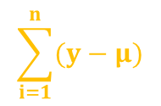


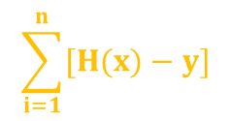
Regression
2
The R statistic is defined as follows:
2
$$\frac{RSS}{TSS}$$
// the higher the better the model fits the data
R = 1 -
measures the accuracy of the regression models
It is the square of the correlation coefficient r
~ so it measures how strong of a linear relationship is
between two variables !!!
RSS - „residual sum of squares”
Measures the variability left unexplained after performing the regression
TSS - „total sum of squares”
It measure the total variance in y
$$\sum_{i=1}^{n}{[H(x)−y]}$$
2
$$\frac{1}{n}$$
$$\sum_{i=1}^{n}{(y−μ)}$$
2

Slide 173

Regression
MEAN SQUARED ERROR (MSE)
It is the difference between the y actual values present in the
dataset (supervised learning) and the H(x) values
predicted by the model
ε
7
ε
ε
8
4
ε
ε
2
5
6
[ H(x) – y ]
ε
„cost-function”
1
ε
3
ε
if this term is small (small error): it means the model
predictions are very close to the actual values GOOD
2
if this term is big (huge error): it means the model
predictions differ from the actual values BAD
$$\sum_{i}{ε}$$
MSE =
2
i

Slide 174

Regression
2
The R statistic is defined as follows:
2
$$\frac{RSS}{TSS}$$
the higher the better the
model fits the data
R = 1 -
measures the accuracy of the regression models
It is the square of the correlation coefficient r
~ so it measures how strong of a linear relationship is
between two variables !!!
RSS - „residual sum of squares”
Measures the variability left unexplained after performing the regression
TSS - „total sum of squares”
It measure the total variance in y
$$\sum_{i=1}^{n}{[H(x)−y]}$$
2
$$\frac{1}{n}$$
$$\sum_{i=1}^{n}{(y−μ)}$$
2

Slide 175
Bollinger Bands (Algorithmic Trading)

Slide 176
Bollinger Bands
this technical analysis approach was first used by John A. Bollinger back in the 1980s
this approach can be used in mean reversion strategies
we can detect overbought and oversold levels as well

Slide 177
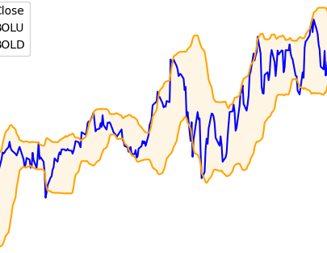
Bollinger Bands
we have a MA(20) indicator
with period 20 days
THIS MOVING AVERAGE REPRESENTS
THE MEAN OF THE TIME SERIES !!!
MA(20) + 2σ this is the
upper Bollinger band
MA(20) - 2σ this is the
lower Bollinger band
S(t)
t

Slide 178
Bollinger Bands
we can detect overbought and oversold conditions
price of the asset falls below the lower band – this is a typical indicator that the asset if oversold
ASSET PRICE IS LIKELY TO INCREASE (SUPPORT LEVEL) !!!
price of the asset breaks above the upper band – this is a typical indicator that the asset is overbought
ASSET PRICE IS LIKELY TO FALL (RESISTANCE LEVEL) !!!

Slide 179
Bollinger Bands Mean Reversion
we can use Bollinger bands in mean reversion trading strategies
if the stock price deviates substantially from the mean or average it eventually reverts back to the mean
IT IS NOT WORKING FINE IN TRENDS
(BULLISH OR BEARISH TRENDS) !!!
for example in a bullish trend it is not advisable to open short positions when the price breaks the upper band (but we can close long positions)

Slide 180
Cross-Sectional Mean Reversion (Algorithmic Trading)

Slide 181
Cross-Sectional Mean Reversion
this is basically a portfolio optimization algorithm
we invest our capital into several stocks (with given w_{i} weights)
our trading algorithm rebalances the portfolio daily

Slide 182
Cross-Sectional Mean Reversion
the trading startegy assumes that the single stock prices
will revert to the mean of the population (universe)

Slide 183
Cross-Sectional Mean Reversion
the trading startegy assumes that the single stock prices
will revert to the mean of the population (universe)
the universe can be the stocks in the S&P500

Slide 184
Cross-Sectional Mean Reversion
the trading startegy assumes that the single stock prices
will revert to the mean of the population (universe)
the universe can be the stocks in the S&P500
short stocks with positive daily returns and long stocks
that have negative daily returns

Slide 185
Cross-Sectional Mean Reversion
the trading startegy assumes that the single stock prices
will revert to the mean of the population (universe)
the universe can be the stocks in the S&P500
short stocks with positive daily returns and long stocks
that have negative daily returns
we assign a w_{i} weigth to every stock in the universe

Slide 186
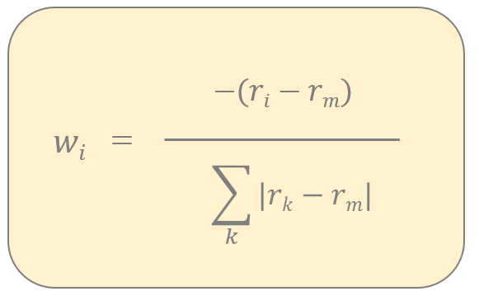
Cross-Sectional Mean Reversion
r_{m} is the return of the universe
(S&P500 for example)
this is the w_{i} weight
for the stock i
these w weights
define how much money
we invest into the
given stocks
w > 0 long position (buy)
w < 0 short position (sell)
THE FURTHER AWAY THE
STOCK’S RETURN FROM
THE MEAN, THE LARGER
THE w_{i} WEIGHT !!!
this is the normalization factor
(the sum of the w_{i} values is 1)

Slide 187
Machine Learning Algorithms (Algorithmic Trading)

Slide 188
Machine Learning
S(t)
we can use machine learning approaches
to learn patterns in the past
WE ASSUME THE SAME PATTERNS WILL OCCUR IN THE FUTURE !!!
past obeservations (lags) are crucial
t
x₁
x₂
x₃
x₄
x₅
x₆
x₇
x₈
x₉

Slide 189
Machine Learning
S(t)
we can use machine learning approaches
to learn patterns in the past
WE ASSUME THE SAME PATTERNS WILL OCCUR IN THE FUTURE !!!
past obeservations (lags) are crucial
t
x₁
x₂
x₃
x₄
x₅
x₆
x₇
x₈
x₉

Slide 190
Machine Learning
S(t)
we can use machine learning approaches
to learn patterns in the past
WE ASSUME THE SAME PATTERNS WILL OCCUR IN THE FUTURE !!!
past obeservations (lags) are crucial
t
x₁
x₂
x₃
x₄
x₅
x₆
x₇
x₈
x₉

Slide 191
Machine Learning
S(t)
we can use machine learning approaches
to learn patterns in the past
WE ASSUME THE SAME PATTERNS WILL OCCUR IN THE FUTURE !!!
past obeservations (lags) are crucial
t
x₁
x₂
x₃
x₄
x₅
x₆
x₇
x₈
x₉

Slide 192
Machine Learning
S(t)
we can use machine learning approaches
to learn patterns in the past
WE ASSUME THE SAME PATTERNS WILL OCCUR IN THE FUTURE !!!
past obeservations (lags) are crucial
t
x₁
x₂
x₃
x₄
x₅
x₆
x₇
x₈
x₉

Slide 193
Machine Learning
S(t)
we can use machine learning approaches
to learn patterns in the past
WE ASSUME THE SAME PATTERNS WILL OCCUR IN THE FUTURE !!!
past obeservations (lags) are crucial
t
x₁
x₂
x₃
x₄
x₅
x₆
x₇
x₈
x₉

Slide 194
Machine Learning
S(t)
we can use machine learning approaches
to learn patterns in the past
WE ASSUME THE SAME PATTERNS WILL OCCUR IN THE FUTURE !!!
past obeservations (lags) are crucial
t
x₁
x₂
x₃
x₄
x₅
x₆
x₇
x₈
x₉

Slide 195
Machine Learning
S(t)
we can use machine learning approaches
to learn patterns in the past
WE ASSUME THE SAME PATTERNS WILL OCCUR IN THE FUTURE !!!
past obeservations (lags) are crucial
t
x₁
x₂
x₃
x₄
x₅
x₆
x₇
x₈
x₉

Slide 196
Machine Learning
LAG #1 | LAG #2 | LAG #3 | DIRECTION
x₃ | x₂ | x₁ | UP
x₄ | x₃ | x₂ | UP
x₅ | x₄ | x₃ | DOWN
x₆ | x₅ | x₄ | UP
x₇ | x₈ | x₉ | DOWN
S(t)
t
x₁
x₂
x₃
x₄
x₅
x₆
x₇
x₈
x₉

Slide 197
Machine Learning
LAG #1 | LAG #2 | LAG #3 | DIRECTION
x₃ | x₂ | x₁ | UP
x₄ | x₃ | x₂ | UP
x₅ | x₄ | x₃ | DOWN
x₆ | x₅ | x₄ | UP
x₇ | x₈ | x₉ | DOWN
S(t)
t
x₁
x₂
x₃
x₄
x₅
x₆
x₇
x₈
x₉

Slide 198
Machine Learning
LAG #1 | LAG #2 | LAG #3 | DIRECTION
x₃ | x₂ | x₁ | UP
x₄ | x₃ | x₂ | UP
x₅ | x₄ | x₃ | DOWN
x₆ | x₅ | x₄ | UP
x₇ | x₈ | x₉ | DOWN
S(t)
t
x₁
x₂
x₃
x₄
x₅
x₆
x₇
x₈
x₉

Slide 199
Linear Regression (Algorithmic Trading)

Slide 200
Linear Regression
„It is an approach for modelling the relationship between scalar dependent variable y and one or more explanatory variables x”
WHY IS IT CALLED LINEAR REGRESSION?
because we use linear
predictor functions

Slide 201
Linear Regression
SIMPLE LINEAR REGRESSION
there is just a single x
explanatory variable
for example we want to predict
house prices based on the size
parameters
MULTIPLE LINEAR REGRESSION
there are several x
explanatory variables
for example we want to predict
house prices based on the
size, district, number of
bedrooms etc
parameters

Slide 202
Linear Regression
WHAT IS THE AIM OF LINEAR REGRESSION?
we want to find linear relationship
between given variables
(features and the target variable)
prices [$]
independent variable we use to
make predictions (size of house)
H(x) = b₀ + b₁ x
dependent variable (target) this is what we
are trying to predict or estimate
(price of the house)
size of houses
in [m²]

Slide 203
Linear Regression
WHAT IS THE AIM OF LINEAR REGRESSION?
wo we build a model based on the dataset
it is a linear model so the result is a linear line
→ the model defines the relationship
between the variables
→ we can make predictions with the
H(x) trained model
What does it mean? If we have a new x feature
(size of the house) we can get the H(x) price
of the house accordingly
prices [$]
size of houses
in [m²]

Slide 204
Linear Regression
we have a dataset (all machine learning algorithm needs one)
we train the algorithm which means finding the linear
relationship between the H(x) and x variables
H(x) = b₀ + b₁ x
OPTIMIZATION !!!
after the training we have the b values which means
we can make predictions with the model
(for new datapoints)

Slide 205
Linear Regression
MEAN SQUARED ERROR (MSE)
It is the difference between the y actual values present in the
dataset (supervised learning) and the H(x) values
predicted by the model
ε
7
ε
ε
8
4
ε
ε
2
5
6
[ H(x) – y ]
ε
„cost-function”
1
ε
3
ε
if this term is small (small error): it means the model
predictions are very close to the actual values GOOD
2
if this term is big (huge error): it means the model
predictions differ from the actual values BAD
$$\sum_{i}{ε}$$
MSE =
2
i

Slide 206
Linear Regression
2
The R statistic is defined as follows:
2
$$\frac{RSS}{TSS}$$
the higher the better the
model fits the data
R = 1 -
measures the accuracy of the regression models
It is the square of the correlation coefficient r
~ so it measures how strong of a linear relationship is
between two variables !!!
RSS - „residual sum of squares”
Measures the variability left unexplained after performing the regression
TSS - „total sum of squares”
It measure the total variance in y
$$\sum_{i=1}^{n}{[H(x)−y]}$$
2
$$\frac{1}{n}$$
$$\sum_{i=1}^{n}{(y−μ)}$$
2

Slide 207
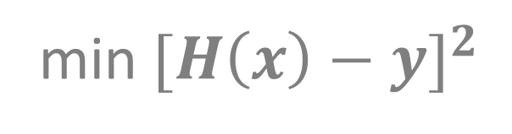
Linear Regression
OPTIMIZATION PROBLEM
this is why optimization algorithms are so important
no matter what problem we are dealing with finally we have to use
some optimization methods to solve it
this is the prediction from
our linear model (linear regression)
we want to find the minimum
by tuning the b
parameters
min ${[H\left(x\right)−y]}^{2}$
b
this is the value we know from
the training data – the label
(supervised learning)

Slide 208
Optimization Techniques
DESIGN MATRIX
APPROACH
we can transform the problem
into linear equations
use the standard method
(using matrix operations)
b = (X^{T}X)⁻¹ X^{T} y
matrix operations are expensive
in higher dimensions
GRADIENT DESCENT
APPROACH
it is a first-order iterative
optimization algorithm
for finding the minimum
of a function
quite efficient even in
higher dimensions

Slide 209
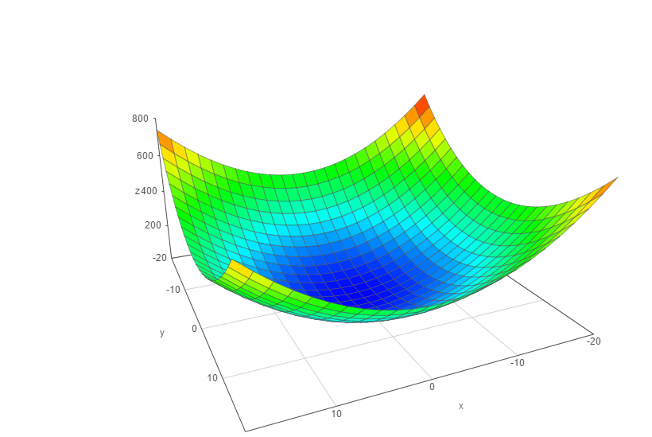




Gradient Descent
we have to know the partial derivative of the C(b) cost function
and go to the direction of the gradient (partial derivative)
C(b)
$$\frac{∂C(b)}{∂b}$$
$$\frac{∂C(b)}{∂b}$$
0
1
the f(x) gradient of a given f(x) function
is pointing in the direction of maximum
Δ
If we are after the minimum but we can use the same
approach with - f(x) instead
Δ
b
1
make iterations {
}
b
$$\frac{∂C(b)}{∂b}$$
$$\frac{∂C(b)}{∂b}$$
0
b ← b – α
b ← b – α
0
0
1
1
0
1

Slide 210
Gradient Descent
C(b)
α: learning-rate
→ small learning-rate: the algorithm takes small
steps towards the minimum but it is more accurate
ALGORITHM TAKES MORE TIME TO CONVERGE !!!
→ huge learning-rate: the algorithm takes larger
steps towards the minimum which means the
algorithm is faster but not as accurate
b
1
b
0

Slide 211
Confusion Matrix
PREDICTED
0
1
122
12
0
ACTUAL
34
89
1
Describes the performance of a classification model
→ diagonal elements are the correct classifications
→ off-diagonals are the incorrect predictions

